Slide 1
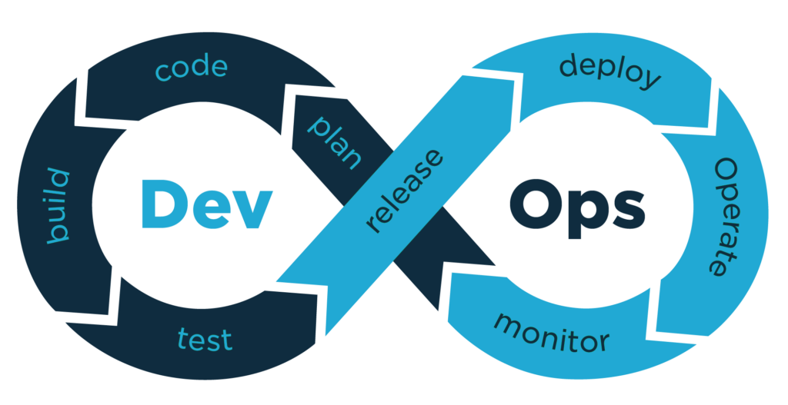
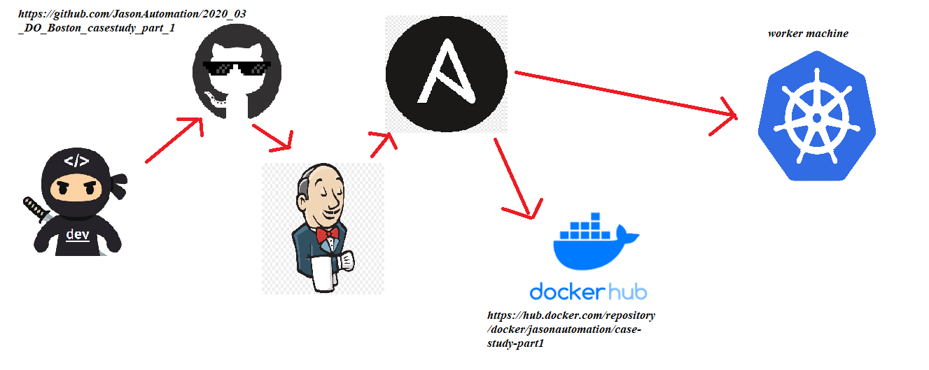
DevOps Pipeline
Jason Kirkcaldy

Slide 2

ASSETS
VM1
Virtual machine 1:
- Ubuntu 18.04 - Jenkins - Ansible - Docker - Git Virtual machine 2:
- Ubuntu 18.04 - Docker - Minikube
VM2

Slide 3
Planning
The goal of this project is to complete a pipeline which will automatically deploy and scale a flask application
Outline of steps to be taken:
Fork github repo and then clone it onto VM1
Create requirements.txt file
Run flask app locally to test
Install Jenkins, Ansible and Docker on VM1
Create docker file with dependencies to containerize the flask app
Build docker image and push to my docker hub repo- https://hub.docker.com/repository/docker/jasonautomation/case-study-part1
Run image locally to ensure application is working in a container
Install minikube on VM2
Create a Kubernetes.yml and test deployment with 3 replicas on VM2
Create an ansible playbook which will pull down my source code, build a docker image and push to my dockerhub repo, then start a Kubernetes deployment on based on the configuration in my Kubernetes.yml. This will be deployed on the target machine (VM2)
Install Ansible plugin in Jenkins and configure installation path (/usr/bin)
Create a Jenkins pipeline which invokes my Ansible playbook

Slide 4
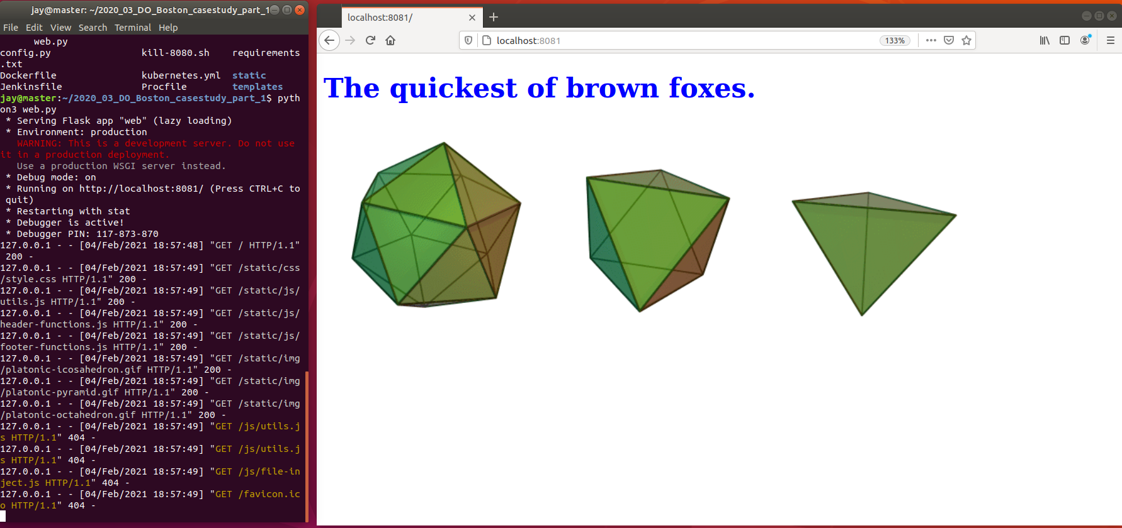
Flask app running locally on port 8081

Slide 5
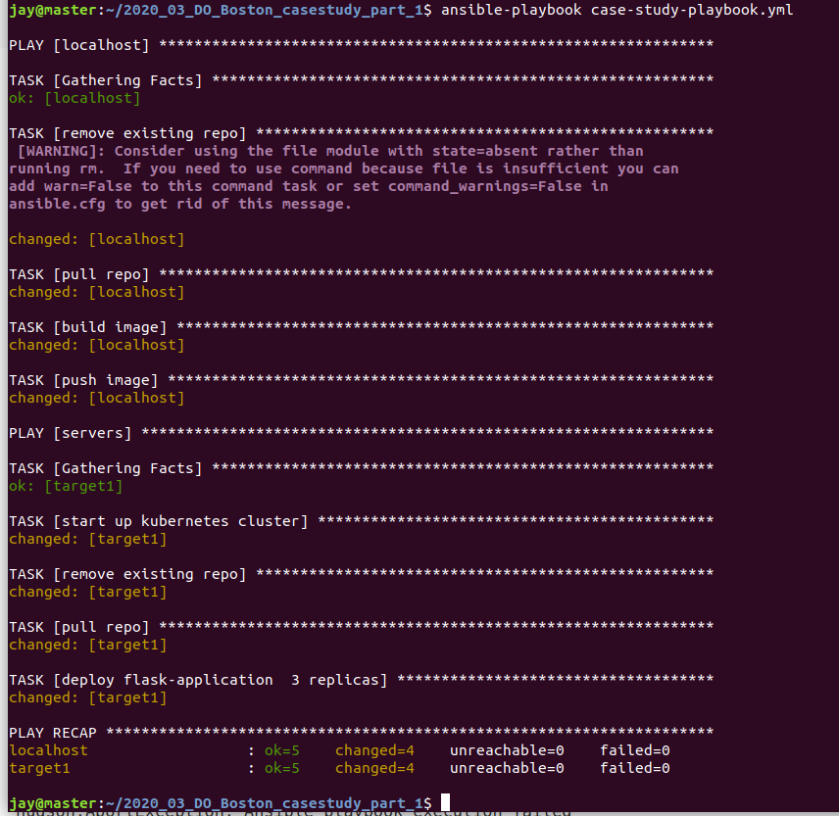
Ansible playbook running from VM1 to target VM2
Pulls github repo (https://github.com/JasonAutomation/2020_03_DO_Boston_casestudy_part_1)
Builds docker image with dockerfile
Pushes docker image to my dockerhub repo: jasonautomation/case-study-part1
SSH’s into target VM
Starts minikube
Removes existing repo
Clones latest repo
Deploys application

Slide 6
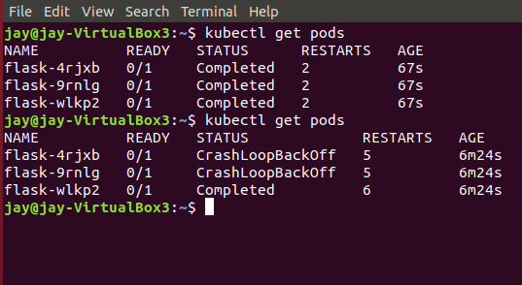
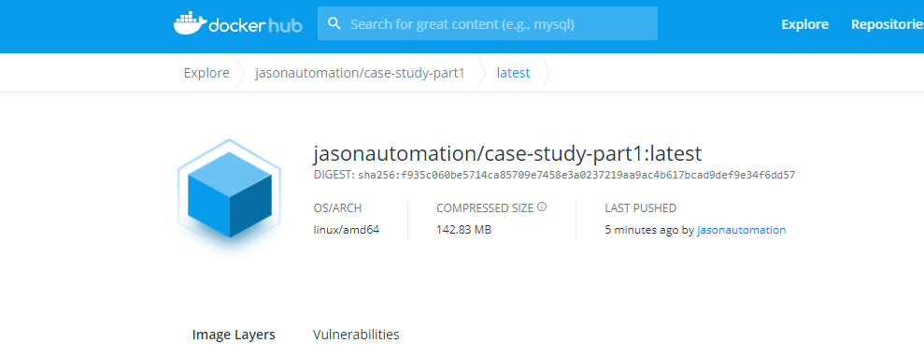
Ansible playbook results:
Current issue with minikube pods
Successfully pushes image to dockerhub

Slide 7
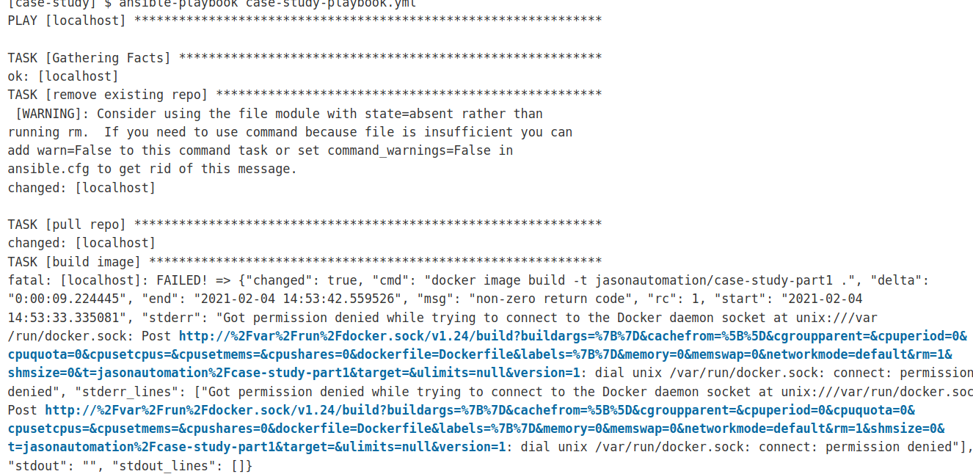
Ansible playbook ran from jenkins

Slide 8
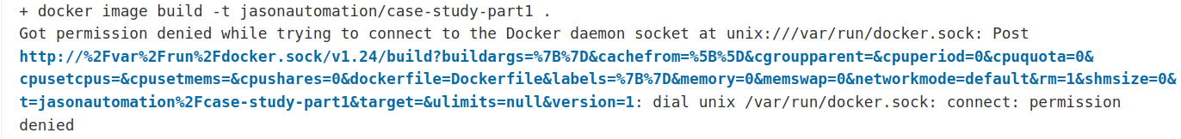
First tried running “usermod -aG docker Jenkins” to add the user Jenkins to the docker group. This did not solve my problem. Running “chmod 777 /var/run/docker.sock” solved this issue, although I am not sure if this is the best way of solving it. This was resolved by renaming my github default branch from “main” to “master”. The issue was that the IP of my target VM changed after a reboot, making the update to the new IP in my /ect/hosts file fixed this.
Issues – resolved

